Slide 1
SEO TECHNICAL AUDIT
A comprehensive on-page and off-site SEO Audit to determine if any technical issues are preventing your site from ranking as well as it should be.

Slide 2

At Logical Position, we believe one of the best ways to achieve success online is through organic search results.
SEO (Search Engine Optimization) is a practice that helps websites get traffic from search engines.
We use this audit to analyze the status of your website's on-page content, off-site linking, and technical aspects. This information is then used to improve keyword rankings and increase organic traffic.

Slide 3

Why do we perform SEO audits?
To show how search engines are indexing your site
To determine roadblocks that are hurting your rankings
To recognize opportunities for increasing organic rankings
The following slide outlines our scope of work for this project and may include recommendations for additional consulting

Slide 4

Executive Summary
The issues outlined below are presented in order of importance, according to our expert analysis.
Site Blocked from Indexing
Content Opportunities
Duplicate Content
Meta Data Optimization
Create Backlinks To Build Website Authority
404 Errors
Broken Internal and External Links
Broken Backlinks
Site Loads HTTPS and Non-HTTPS
Internal and External Redirect Links
Search Console 404 Errors
Site Not Secure
Site Loads Mixed Resources
Site Loads WWW and Non-WWW
Mobile Friendly Issues
Canonicals Set Up Incorrectly
No Canonicals
No XML Sitemap
Site Speed Improvements
Product Pages Linked on Site Do Not Reflect /Product Pages in Sitemap
Broken Pages in Sitemap
Redirected Pages in Sitemap
Structured Data Errors
No Structured Data
Canonicalized URLs in Sitemap
Noindex Pages in Sitemap
No Blog/Blog Off-Site
Site 404s if Trailing “/” Removed
Site Loads With and Without a Trailing “/”
Could Benefit from CTAs
Unnecessary Pages In Sitemap
URLs in Multiple Sitemaps
Orphaned Pages
Missing Alt-Text
*The teal-colored issues are items that your website developer would need to address
*The purple-colored issues are items that are lower impact items with regards to SEO

Slide 5
Keywords: Why They Matter
An effective Keyword Strategy helps optimize text-based content. Keywords give clues to search engines, so they know what each page is about.
It is important to target keywords that are relevant to your page and business. This way, when a user searches for something related to your business, your page will show in the results.
Here is a current snapshot of your organic keyword rankings:

Slide 6
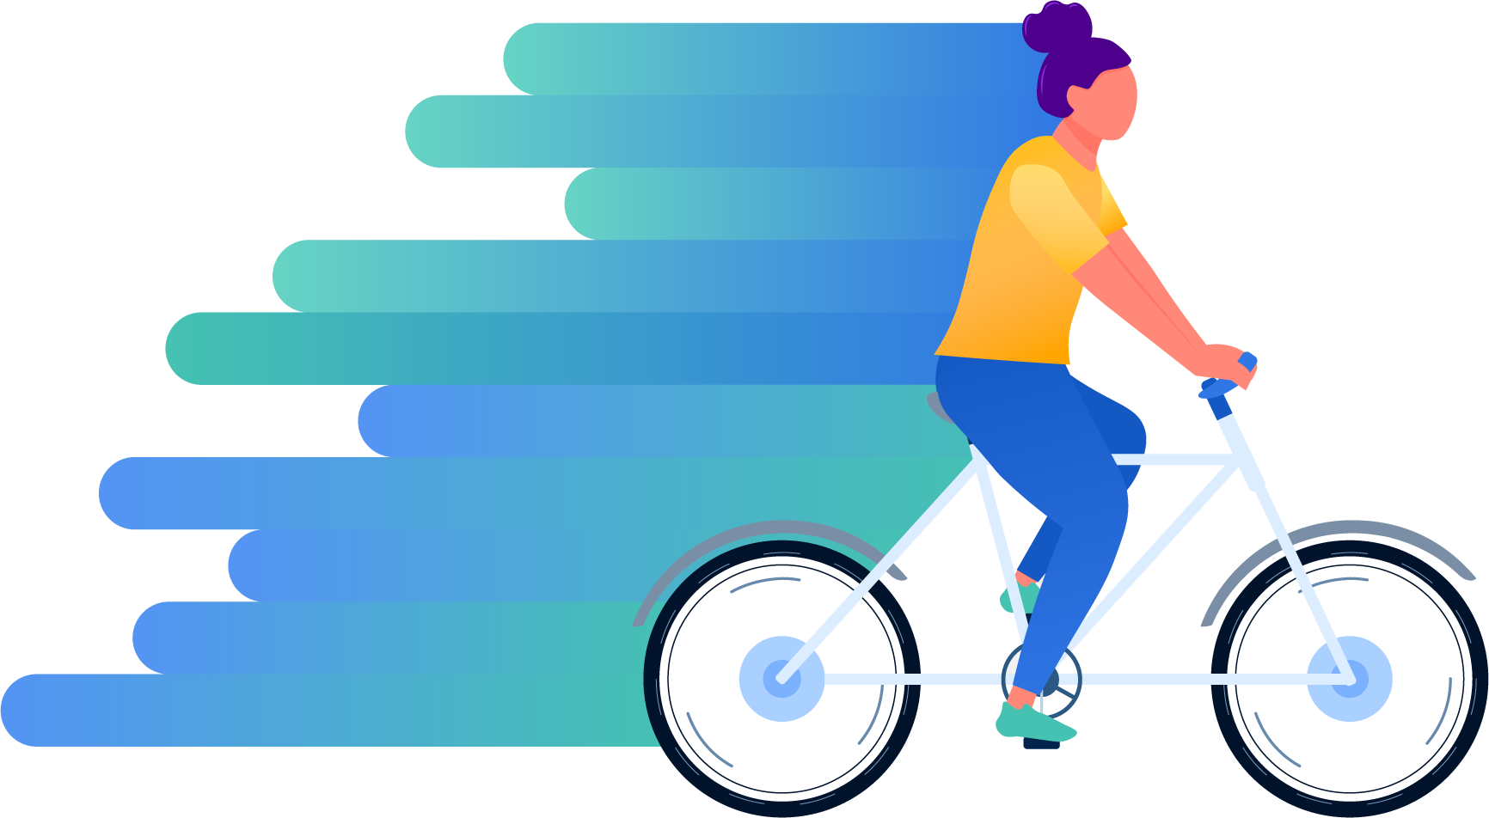
Search Console and Analytics
Google Search Console and Google Analytics allow us to monitor your site’s indexing status and organic performance.

Slide 7
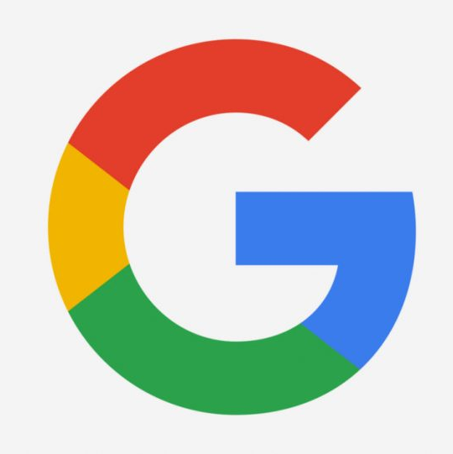
Google Analytics & Search Console
Google Search Console and Analytics are important resources to monitor SEO performance and site health. We reference these tools extensively during our technical audits and SEO work. If we do not have access to your Search Console and Analytics, we may not be able to provide the most accurate data.
Do we have access to Search Console?
Do we have access to Analytics?
Yes
Yes
Notes:
OSRS ONLY: IF WE DON’T HAVE SEARCH CONSOLE
https://support.google.com/webmasters/answer/7687615?hl=en

Slide 8

Google recommends a "mobile first" mentality when it comes to website optimization.
Google predominantly uses the mobile version of the content for indexing and ranking. We always check to ensure your site’s mobile version properly represents your desktop version.

Slide 9
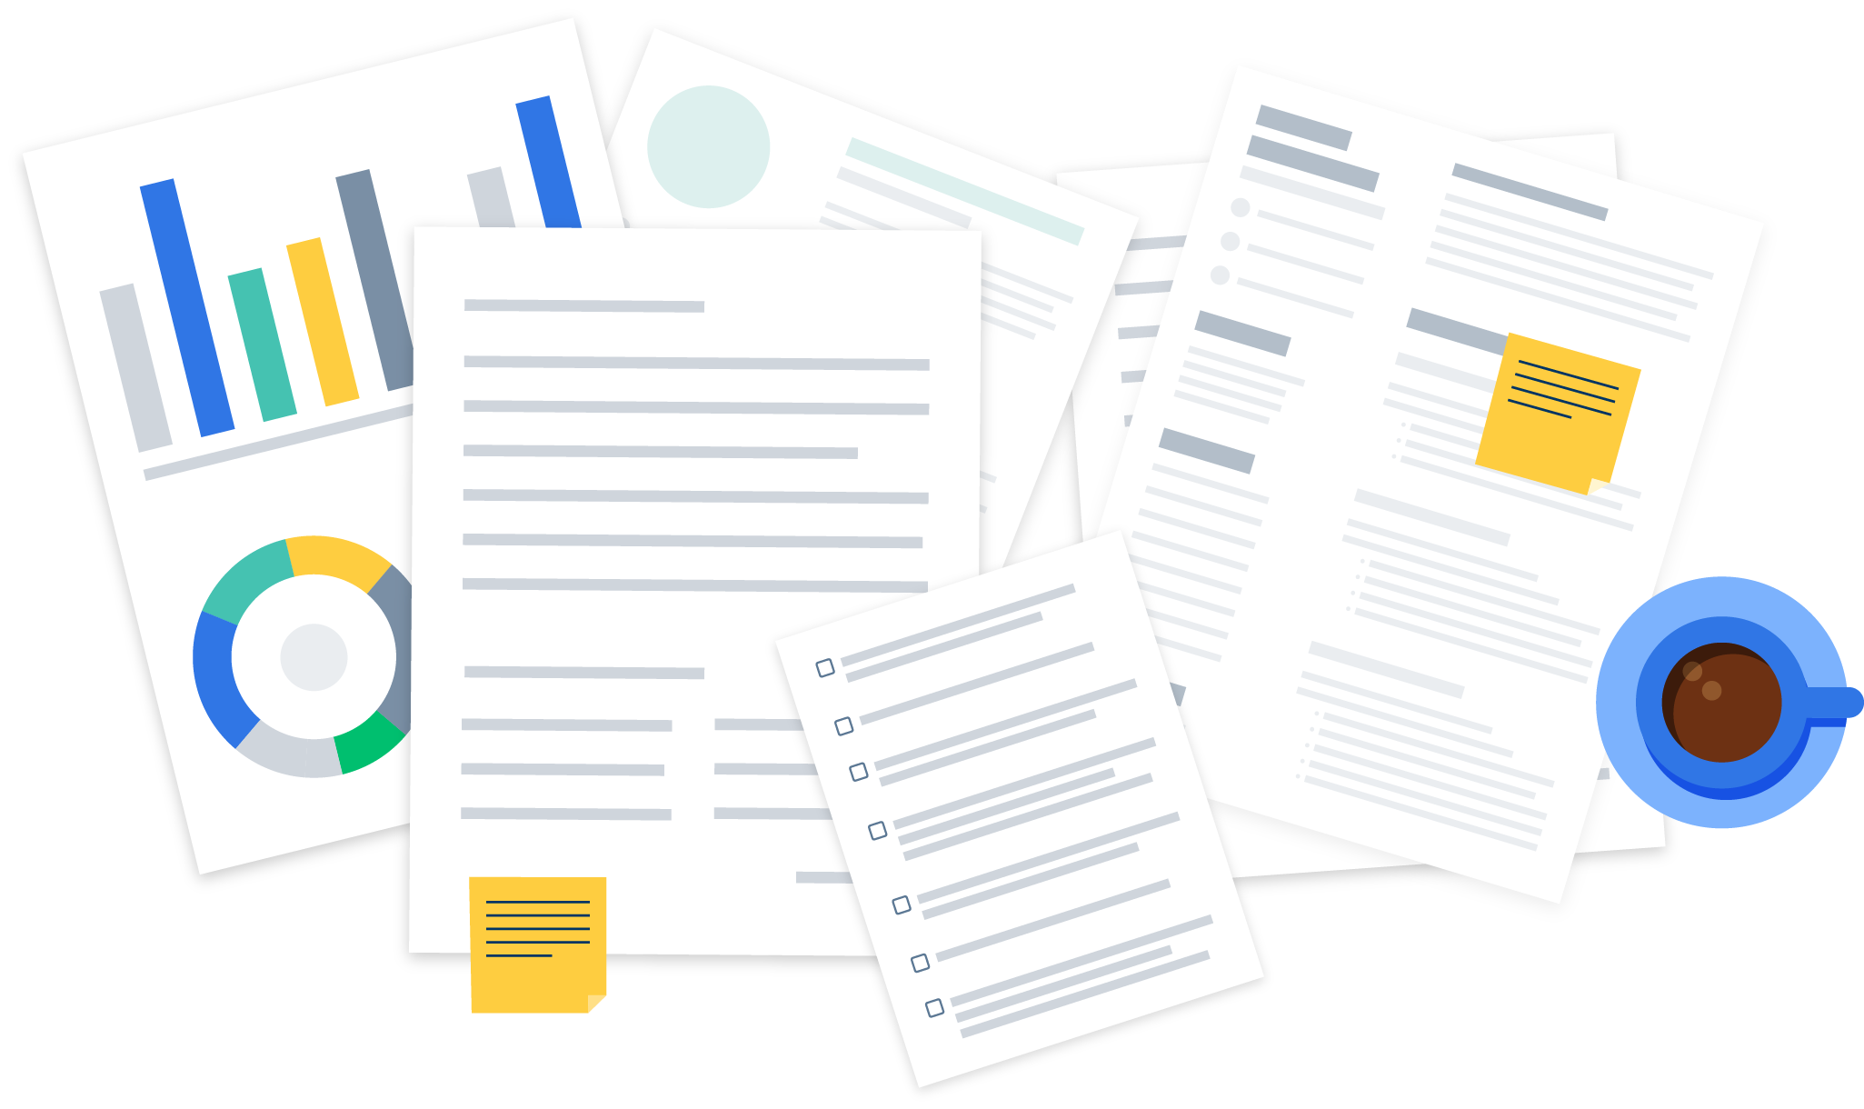

Google Search Console
Analyst Notes
Site-Wide Mobile Usability
Your site is mobile-friendly.
Mobile Usability Issues
Link and anchor text to SC Mobile Usability export.
00
We use Google Search Console to look for pages with mobile-friendly issues.
With Google’s mobile-first approach to indexing, it is important that your visitors can easily view your entire site on their mobile devices.
Notes:
We found that # of your pages are NOT mobile-friendly. We recommend making your pages mobile-friendly, so visitors can easily view your site on their mobile devices.
IF WE DON’T HAVE SEARCH CONSOLE ACCESS
We use Google’s Mobile-Friendly Test to ensure your homepage is mobile-friendly.

Slide 10
Search Console: Do you have an XML sitemap?
An XML sitemap lets search engine crawlers navigate pages easier because it lists every page on your website.
Is your sitemap submitted through Google Search Console?
Are there any errors on your sitemap?
Yes
Yes
Analyst Notes
We found your sitemap. It’s located here:
https://www.logicalposition.com/sitemap.xml
Link/s for XML sitemal exports.
Notes:
Your sitemap contains broken and redirected pages. You can view the broken pages here, and the redirected pages here. Your sitemap should only contain 2xx-status pages. Your sitemap contains orphaned pages. If they are relevant pages, we recommend linking them on your site. If they are not relevant, we recommend removing them from your sitemap. You can view them here.
We could not find a sitemap. We recommend creating a sitemap and submitting it through Google Search Console.
We found your sitemap, which looks correct according to best SEO practices. It’s located here:
We found canonicalized URLs in your sitemap. We recommend only having pages you want to be indexed in your xml sitemap.

Slide 11
Robots.txt
A Robots.txt file tells search engine crawlers which pages they are allowed to crawl on your website as well as which pages are blocked. Noindex and Nofollow tags stop crawlers from indexing and following links to affected pages. We recommend blocking pages that do not need to be indexed (e.g., pages that contain login information, shopping cart pages, etc.)
However, disallowing or noindexing pages that need to be indexed can risk SEO rankings. Google has suggested that websites allow their Javascript files and CSS files to be readable by search engines to help with how they are rendered.
Analyst Notes
Your site currently has a robots.txt file and blocks pages that do not need to be indexed. It can be found here: https://logicalposition.com/robots.txt.
Notes:
We found that your site does not have a robots.txt file. We recommend creating a robots.txt file, so you can block pages that do not need to be indexed.
We found that your site has pages that should be indexed being blocked by noindex tags. We recommend removing the noindex tags to prevent this.
We found that your site has a robots.txt file; however, it does not block shopping cart pages, pages that contain login information, and other account pages. We recommend updating the robots.txt file to block these pages.

Slide 12
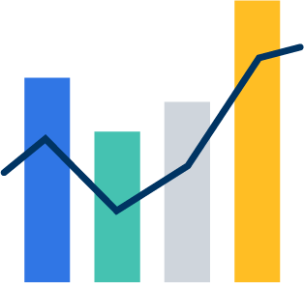
Search Console: Structured Data
Structured data is code added to your website that allows search engines to understand the data on a page better. It can explain product pricing, concert venue locations, article authors, business telephone numbers, and more.
Structured data is an important piece of the SEO puzzle. If your site currently has structured data, we will make sure it’s implemented correctly. We will also look for errors that pertain to your code.
Analyst Notes
We found that your website has structured data. We found no errors with your structured data.
Notes:
We found that your website does not have structured data. Structured data can be beneficial to you and your customers. Accurate structured data can help with rankings, while visitors immediately receive pertinent information about the website. We recommend creating structured data for your website.
We found that your website has structured data; however, there are # items with errors. We recommend updating the missing fields or descriptions to eliminate these errors.

Slide 13

On-Page SEO
On-Page SEO covers everything from meta data to content.

Slide 14
On-Page SEO: How are your page titles?
Meta Titles or Page Titles (in blue) help determine how well crawlers understand and index the page. It is important to have relevant titles that reflect on-site content.
Missing Titles
Empty Titles
Duplicate Titles
00
00
00
When we perform a technical audit, we look for titles that are:
Keyword-targeted and user friendly
Unique from one another
Less than 60 characters
Short Titles
Long Titles
00
00
Analyst Notes
After reviewing your titles, most titles are over 60 characters, although we found that your titles are keyword targeted. There are no duplicate titles.
We recommend creating page titles that are user-friendly, keyword-targeted, unique from one another, and 60 characters or less. You can find all your titles listed here.

Slide 15
On-Page SEO: How are your meta descriptions?
Meta Descriptions (in black) summarize what is on that page. Descriptive meta-content and a call to action can help increase click-through rate (CTR).
Missing Descriptions
Empty Descriptions
Duplicate Descriptions
00
00
00
When we perform a technical audit, we look for descriptions that are:
Useful and enticing to the user
Unique from one another
Less than 160 characters
Short Descriptions
Long Descriptions
00
00
Analyst Notes
After reviewing your descriptions, all of them are under 160 characters and unique to one another. However, they could use better keyword targeting.
We recommend creating meta descriptions that are informative, unique, keyword-targeted, less than 160 characters, and have a CTA. You can find all your descriptions listed here.

Slide 16

On-Page SEO: How are your H1s?
An H1 is an on-page title element that explains what the page is about. This is a perfect opportunity to focus on the page’s main keyword.
When we perform a technical audit, we look for H1s that are:
Keyword Targeted
Unique from one another
An accurate summary of the content on your page
Missing H1s
Empty H1s
Multiple H1s
Duplicate H1s
00
00
00
00
Analyst Notes
After reviewing your H1 tags, we found that many of them could be better keyword-targeted. We found some duplicate H1 tags.
We recommend writing H1 tags that are brief and uniquely summarize each page. We also noticed multiple H1s on some pages. We recommend only having one H1 per page. You can find all your H1 tags listed here.

Slide 17

On-Page SEO: Site Content and Overall Experience
Content quality and quantity are important ranking factors; the less quality content you have, the lower your rankings will be.
Having unique and substantial text on your web pages will help prevent the dreaded “thin content” issue we run into often. Thin content can cause a page to rank poorly and can even keep it from being indexed.
Paying attention to the user experience and content on your website is very important when it comes to best SEO practices.
Analyst Notes
We found that you have thin content. We recommend adding more content to your website’s pages. This will help crawlers understand the products and services your website offers. This can also help your site rank better in the long run.
Notes:
We also found duplicate content .
After reviewing your site, we found that you have quite a bit of content. While this is a great start, we recommend adding keyword-targeted content. This will help crawlers understand the products and services your website offers, and you will also be able to rank better in the long run.
We found that you have unique and substantial content on your site.
We found that you have thin content. We recommend adding more content to your website’s pages. This will helps crawlers understand the products and services your website offers. This can also help your site rank better in the long run.

Slide 18
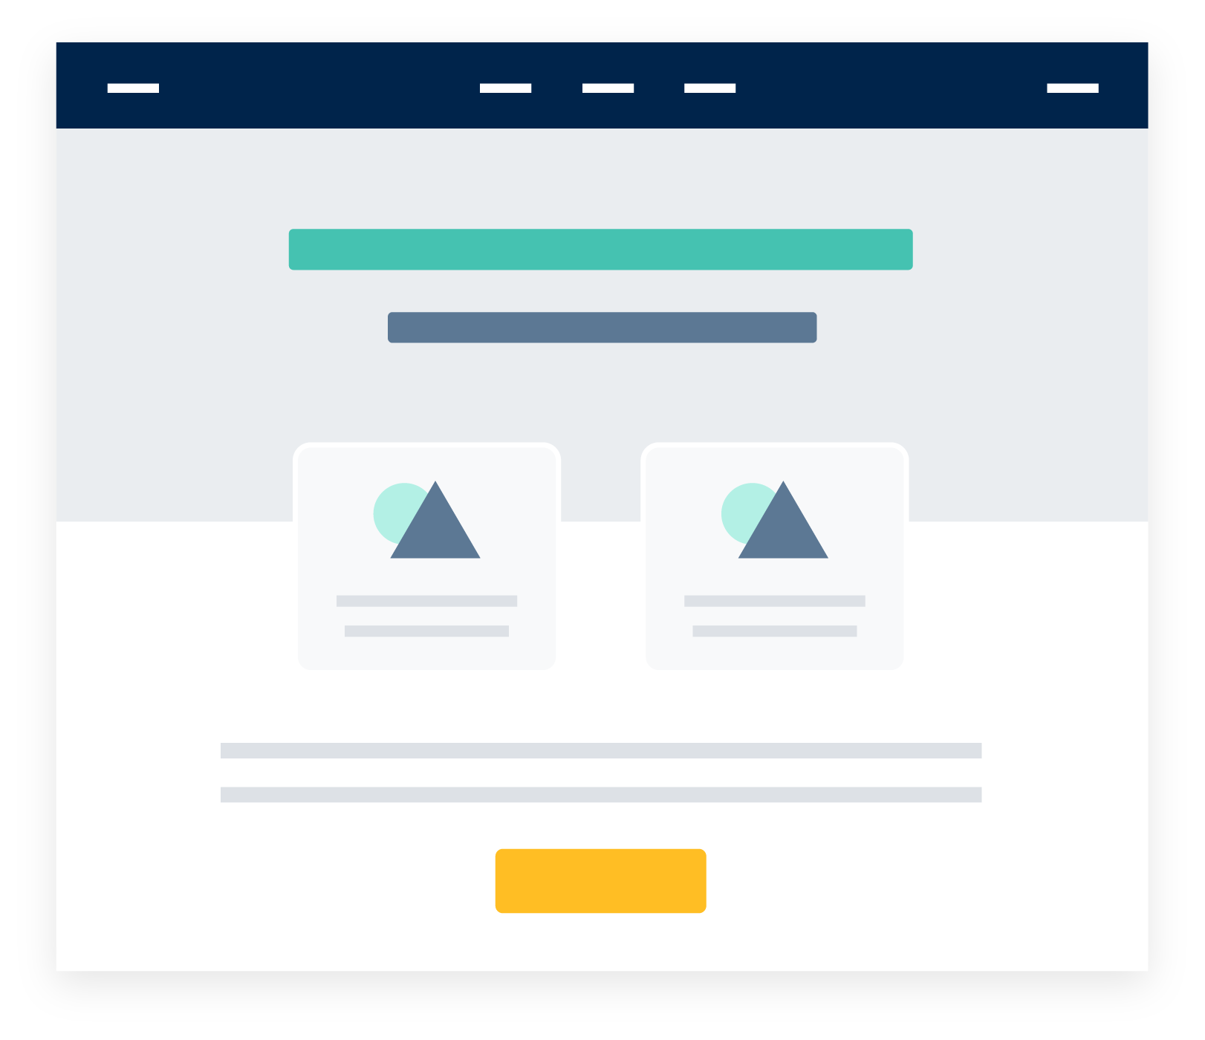
On-Page SEO: Internal and External Duplicate Content
Duplicate Content is content that repeats across your website or appears on another website. As an SEO best practice, avoid using the same content for multiple pages. Search engine crawlers can detect this and confuse it with spam. This will cause search engines to ignore important pages on your website. We use Siteliner to find duplicate content on your site and Copyscape to discover duplicate content on the web.
Analyst Notes
We found no instances of duplicate content.
Notes:
We found that there are several instances of duplicate content across your site, primarily on your category pages. We recommend writing original content for each page. This can increase readability and rankings.

Slide 19
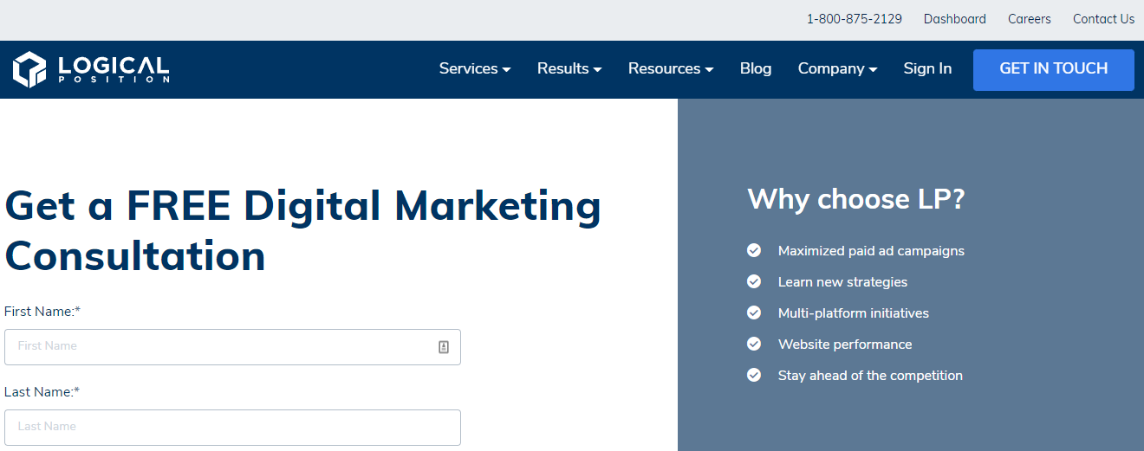
On-Page SEO: Calls-to-Action
Calls-to-Action (CTAs) can improve click-through rates. CTAs are instructions that encourage your audience to immediately respond (e.g., “click here” or “call today”).
We suggest well-placed CTAs on your web pages that will be easily seen and read by potential customers.
Analyst Notes
We found that your site has great CTAs. Calls to action, such as the phone number on the top right-hand side of the page, can draw in interested visitors. This can help with click-through rate and conversions.
* CTA example from Logical Position
Notes:
We found that your site could benefit from visible CTAs. Clear contact forms, phone numbers, and addresses can help with click-through-rate and conversions. We recommend creating accurate and visible CTAs throughout your website.

Slide 20

On-Page SEO: Does Your Site Have a Blog?
An on-site blog is a great way to provide fresh content to visitors. Posting at least once a month can help your SEO efforts, as it’s an easy way to collect backlinks and generate more targeted traffic.
Do you have an
on-site blog?
Is it updated regularly?
Yes
Yes

Slide 21

On-Page SEO: Image ALT-Text
Image Alt-Text describes the contents of an image to a search engine. This also provides image information to users who cannot otherwise view it (e.g., they are using a screen reader, they have a slow connection).
We recommend including image alt-text on your website’s images to improve overall accessibility of your site. Please view the official USAGov guidelines at https://www.usa.gov/accessibility-policy.
Analyst Notes
Missing Alt Text
We found that your website’s images have alt text.
00
Notes:
We found that your website’s images have image alt-text.

Slide 22

Technical SEO
Technical SEO addresses technical issues with your website that may impact rankings. This covers everything from 404 errors to page speed.

Slide 23
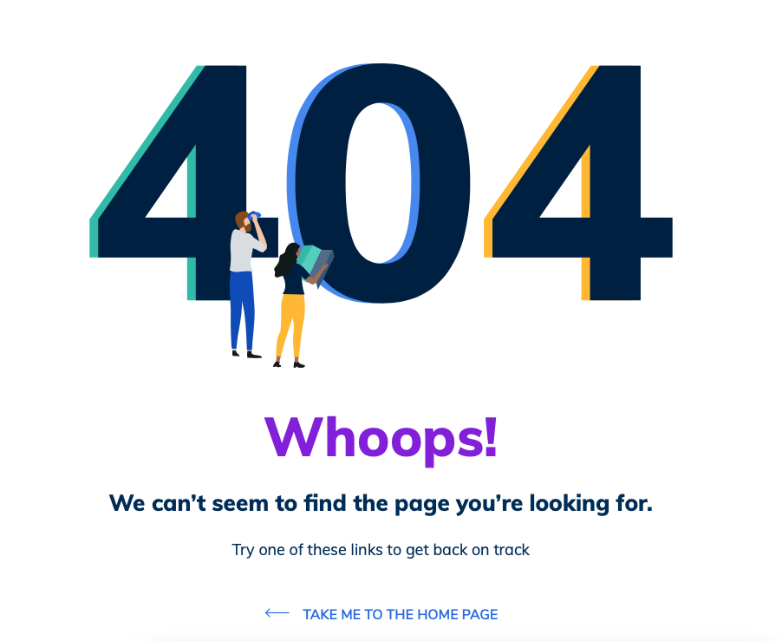
Technical SEO: 404 Errors
404 errors let users know that a page cannot be found. This could mean your page is no longer active.
Generally, 404s are undesirable for SEO because they limit usability.
Broken Internal URLS
Broken External URLs
Analyst Notes
00
00
We found that your site has no 404s.
Crawl Anomalies
Search Console 404s
00
00
Link/s for export files
Soft 404s
External Broken Redirects
00
00
Notes:
We found that your site has # broken internal links and # broken external links. You can find the broken internal links here, and the broken external links here. Google Search Console also found # 404 errors; they can be found here. However, we identified that only # need to be addressed. # crawl anomalies were also found, they can be found here. It also found # soft 404 errors, which can be found here. A soft 404 is a URL that returns a page telling the user that the page does not exist and also a 200-level (success) code. In some cases, it might be a page with little or no content--for example, a sparsely populated or empty page. If there is a new URL for any of these 404 errors, we recommend redirecting the broken URL to that new page. If no URL exists, we recommend redirecting the broken URL to a relevant 2xx page. We recommend replacing the broken links with a new link or removing them from any pages they appear on.
We also found that you do not have a proper 404 page. We recommend creating a custom 404 page.

Slide 24
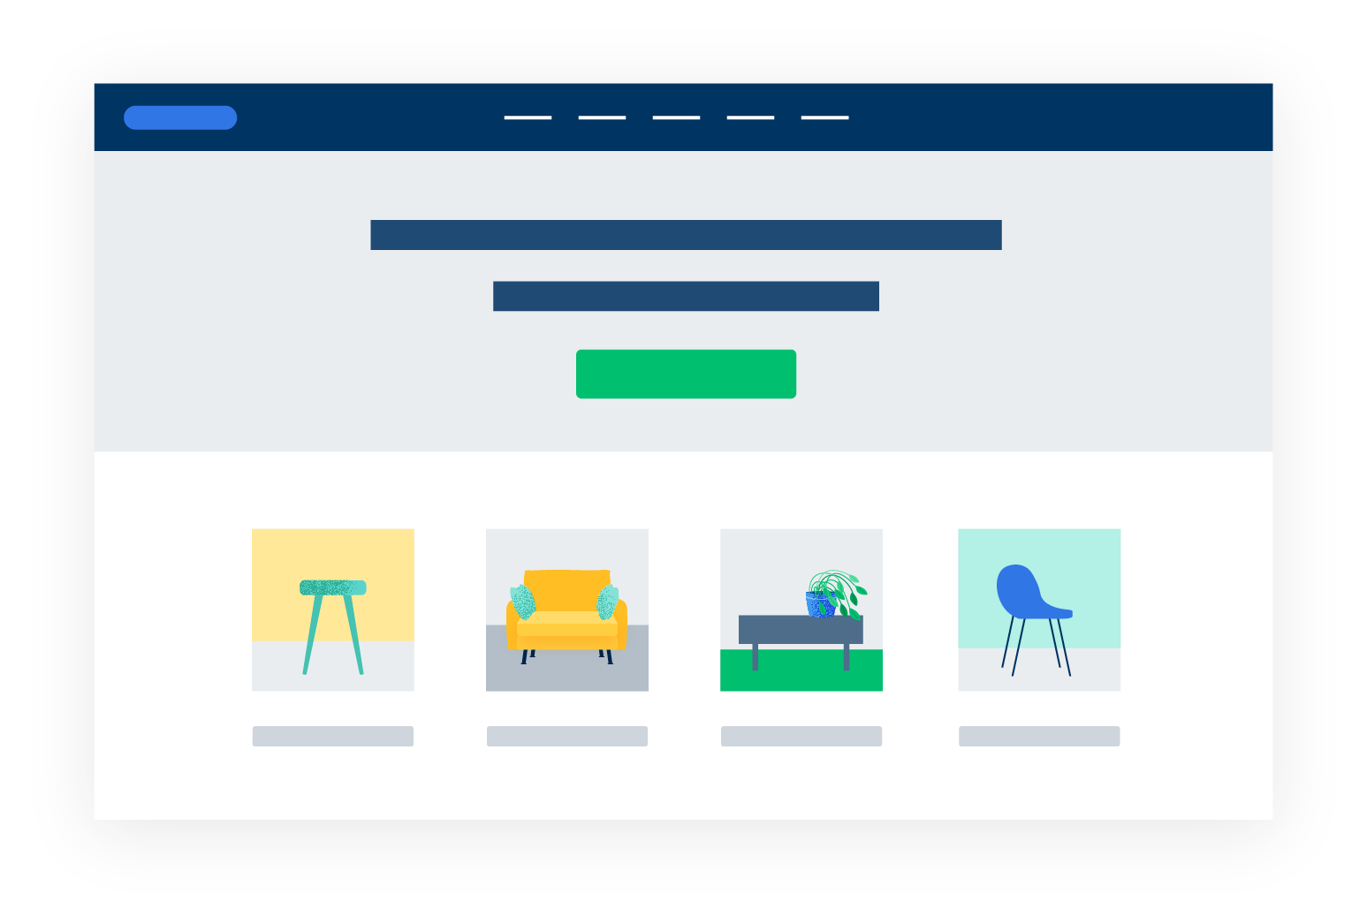
Technical SEO: Canonicals
Canonicals help tell search engines that there is a master version of a specific page. For example, let’s say you have an e-commerce site, and on one of the pages, you sell shorts. The fifth page of shorts should have a canonical that points back to the first page of shorts.
By using canonicals, you are avoiding duplicate content across multiple URLs.
Canonicals are used just by search engines and have no effect on user experience.
Analyst Notes
After reviewing your site, we found that your site has canonicals, and they are correct according to the best SEO practices.
Notes:
We found that your pages do not have canonicals; however, it looks like canonicals are unnecessary at the moment since you do not have a lot of duplicate content. If you add a blog, canonicals may be necessary.
We found that your pages do not have canonicals. We recommend pointing filtered or paginated pages back to the first page to avoid duplicate content.
We found that your canonicals are not set up properly. We recommend pointing filtered or paginated pages back to the first page to avoid duplicate content. This includes tagged collection pages, which are dynamically generated and cannot be edited. We recommend pointing tagged pages back to the original collection page.

Slide 25

Technical SEO: Redirects
Redirects direct users from one URL to another. They can be used to point old pages to new pages, but if used incorrectly, they can decrease SEO rankings. Having an abundance of redirects within your site’s link structure should be examined and corrected.
Redirect Chains
Internal Redirect Links
External Redirect Links
00
00
00
Analyst Notes
We found no issues with your redirects.
Notes:
We found # internal redirect links and # external redirect links on your site. You can find the internal redirect links here, and the external redirect links here. We recommend correcting these links with their new 2XX-status URLs.
We also found that your site loads both HTTPS and non-HTTPS, WWW and non-WWW. We also found that your site loads with and without a trailing “/”. This can create duplicate content. We recommend redirecting your site to HTTPS, WWW/non-WWW, or with or without the trailing “/” version of your site.
We also found redirect chains and loops.
We found that the product pages linked on your site do not reflect the format of the ones listed in your sitemap. We recommend linking the /products version of your pages.

Slide 26

Technical SEO: Website Security
A secure website will help you generate more sales and achieve greater SEO results. Users are more likely to complete a transaction if the website is secure (HTTPS). As of July 2018, Google Chrome began marking plain HTTP sites as “not secure.” Site security can also be a ranking factor since Google places more value on secure websites.
We recommend that you have a secure website. Your website’s resources should also be secure; otherwise, the page will be marked as “not fully secure.” Additionally, the SSL certificate must be up to date to maintain your website’s secured status.
Analyst Notes
We found that your website is secure as it uses an SSL and loads in HTTPS.
Notes:
We found that your site is not secure, as it does not load in HTTPS. We recommend that your site switch to HTTPS.
We found that your site has HTTPS; however, the SSL certificate has expired. We recommend renewing your SSL certificate.
We found that your site has HTTPS; however, it loads mixed resources. We recommend ensuring that your site’s resources load securely.

Slide 27


Technical SEO: Page Speed
A site optimized for page speed can increase rankings, traffic, and usability.
A fast website creates a better user experience; most users will leave a website if it takes longer than 3 seconds to load. Google prefers websites that load quickly and offer a premium user experience. As a result, a faster website typically results in better organic rankings. We use Google’s PageSpeed Insights to test your home page and measure mobile and desktop load time.
When considering load time improvements, it is important to familiarize yourself with some of the available options. Caching, better web hosting, and image optimization can be relatively easy to implement. Changes to your website’s structure, design, and JavaScript elements can be more difficult.
While a faster website is better, it may not always be necessary—or possible—on some platforms. It is best to have a conversation with your website developer to determine what improvements can be made and what impact those changes will have on your website’s design and functionality.
Mobile Load Time
2.5
sec
Desktop Load Time
2.5
sec

Slide 28

Off-Page SEO
Outside factors that affect your rankings.

Slide 29
Off-Page SEO: Authority Score and Linking Domains
Authority Score: Authority Score is Semrush’s metric measuring the domain’s reputability. It accounts for the number and quality of its backlinks, organic search traffic, and overall authenticity of its profile.
Referring Domains: This number represents the total number of referring domains with at least one link pointing to your website.
Backlinks: This number represents the total number of backlinks pointing to your website.
Authority Score
Referring Domains
Backlinks
00
00
00
Analyst Notes
Increasing your site’s authority is an important step in raising your overall rankings. We suggest spending some time building relevant backlinks. This can raise your site’s overall authority in the eyes of the search engines.
Notes:
Increasing your site’s authority is an important step in raising your overall rankings. During the course of your campaign we will work to build relevant backlinks. This can potentially raise your site’s overall authority in the eyes of the search engines.

Slide 30
Off-Page SEO: Backlinks
Backlinks are links from other websites that point to your website. When a website has a link pointing to your site that results in a 404, it is called a “Broken Backlink.”
Fixing broken pages or redirecting them to a current and relevant page will help your website's authority by maintaining working links.
We use Semrush as a tool for finding broken backlinks. It lists the corresponding webpage as well as its authority score.
Analyst Notes
We found 0 broken backlinks.
404
You can view them here.
Notes:
We found # broken backlinks. You can view them here. To help maintain your website’s authority, we recommend fixing broken backlinks from relevant, high-authority domains.

Slide 31
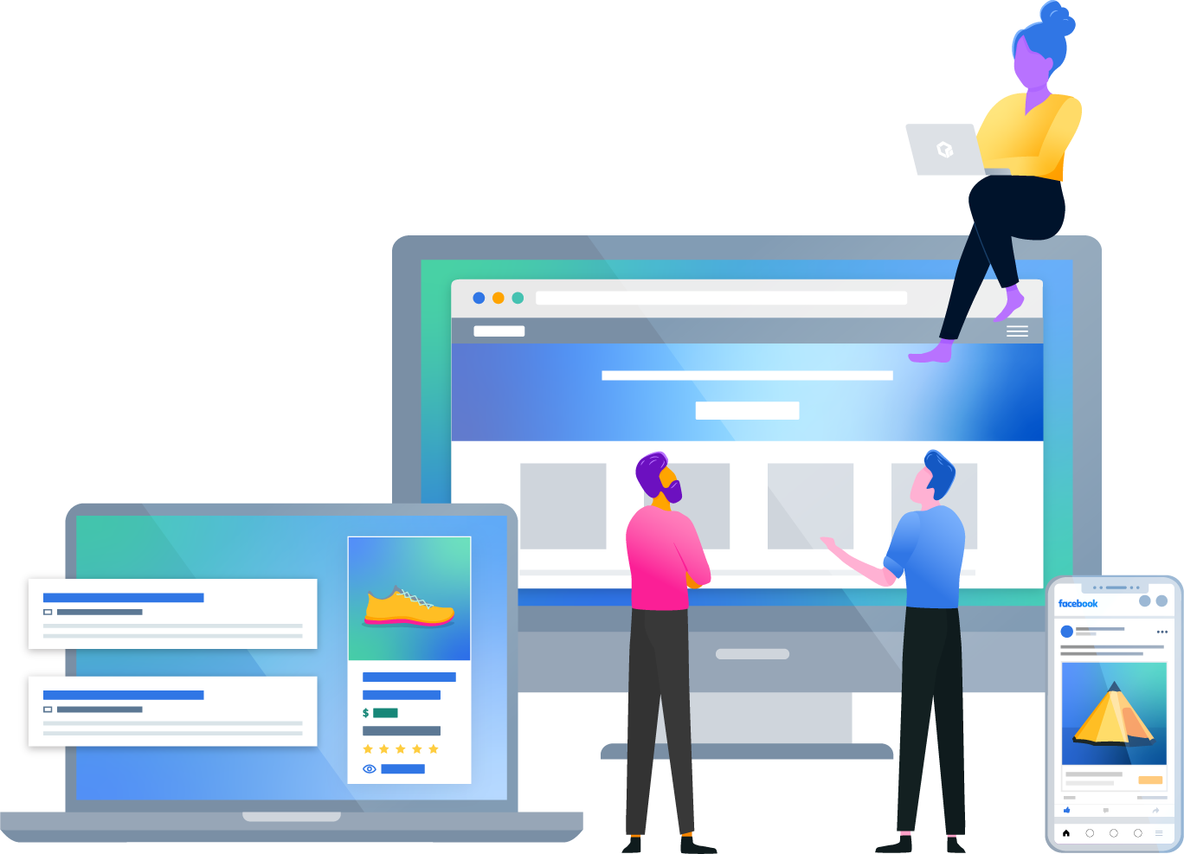
Thank you
We look forward to working with you

